Slide 1
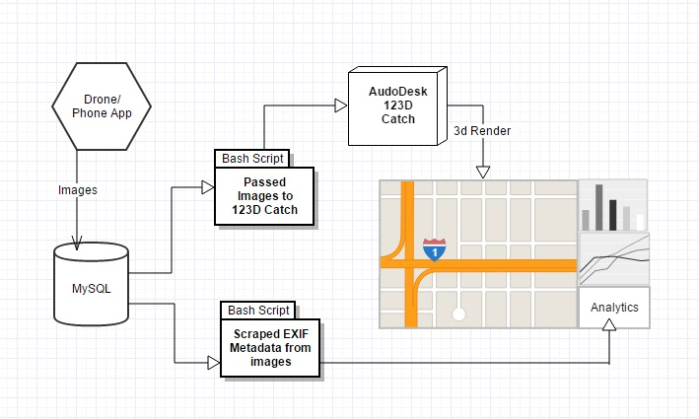
Server Infrastructure Overview

Slide 2
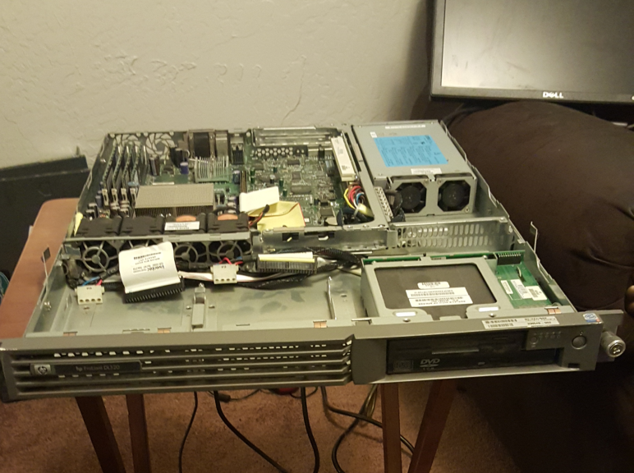
Primary Database Server
Running Xubuntu 15.10
Uses MySQL to hold the images
Uses several bash scripts
to process the images
HP ProLiant DL320

Slide 3
Server Side Code
Formats images to a uniform size
Scrapes image metadata
Enforces image naming conventions
Creates a master content list
Passes images to Autodesk 123D Catch

Slide 4
Autodesk 123D Catch
Creates 3D objects using a large set of images

Slide 6
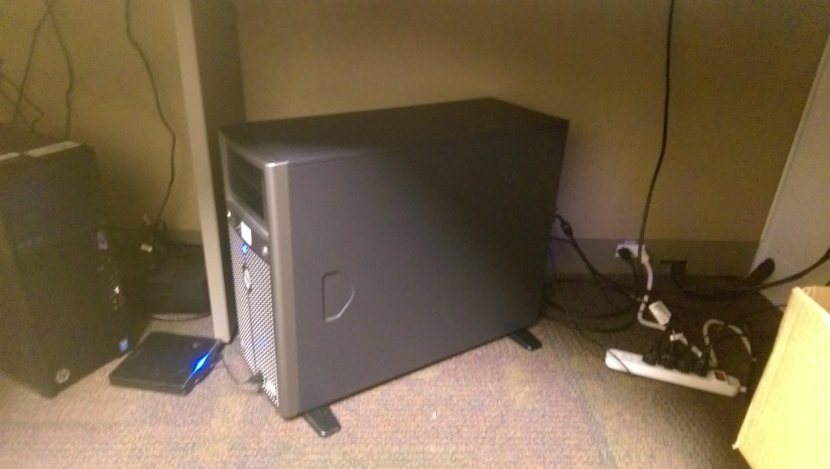
Webserver
Need data
Need data
Need data

Slide 7
Analytical Information
Using data both from the drone’s flight path and from the phone we can run high level analytics.
Average speed, estimated distance between images, GPS information
Could be compiled into an automated report to emailed after each flight

Slide 8
Image of website here

Slide 9
Future Improvements
Asd
Sdf
Sdf
Sdf

